Slide 1
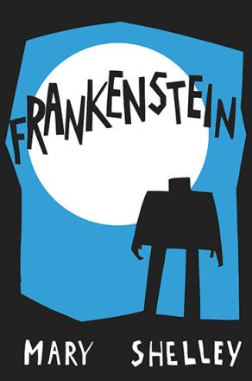
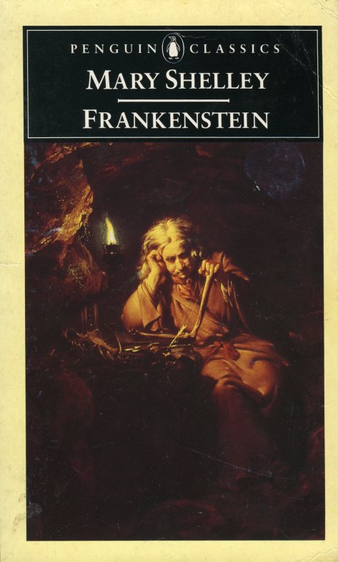
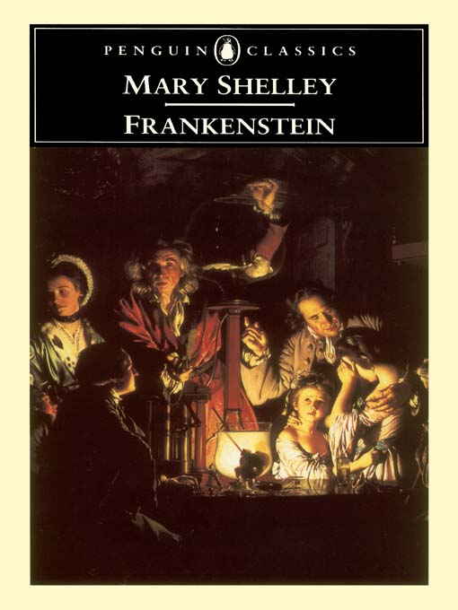
Frankenstein
Critical perspectives

Slide 2
Aspects of Close Analysis/Reading
Close reading is a method of literary analysis which focuses on the specific details of a passage or text in order to discern some deeper meaning present in it.
The meaning derived from the close reading is the reader's interpretation of the passage or text.

Slide 3
Aspects of Close Analysis/Reading
Step 1: Read the passage repeatedly. Take notes as you read.
Step 2: Analyze the passage.
Step 3: Develop a descriptive thesis.
Step 4: Construct an argument about the passage.
Step 5: Develop an outline based on your thesis.

Slide 4
Elements of fiction
Plot - How the author arranges events to develop the basic idea; it is the sequence of events in a story or play. The plot is a planned, logical series of events having a beginning, middle, and end.
The short play or story usually has one plot so it can be performed or read in one sitting.
There are five essential parts of plot:
Exposition (introduction) - Beginning of the story; characters, background, and setting revealed
Rising Action - Events in the story become complicated; the conflict is revealed. These are events between the introduction and climax.

Slide 5
Elements of fiction
Conflict - Essential to plot, opposition ties incidents together and moves the plot. Not merely limited to arguments, conflict can be any fOfI1)of struggle the main character faces.
Climax - Turning point of the story. Readers wonders what will happen next; will the conflict be resolved or not?
Falling action - Resolution begins; events and complications start to fall into place. These are the events between climax and finale.

Slide 6
Elements of fiction
Setting - Time and location that a story takes place. For some stories, the setting is very important; while for others, it is not.
When examining how setting contributes to a story, there are multiple aspects to consider:
Place - Geographical location; where is the action of the story taking place?
Time - Historical period, time of day, year, etc; when is the story taking place?
Weather conditions - Is it rainy, sunny, stormy, etc?
Social conditions - What is the daily life of the character's like? Does the story contain local colour (writing that focuses on the speech, dress, mannerisms, customs, etc. of a particular place)?
Mood or atmosphere - What feeling is created at the beginning of the story? Cheerful or eerie?

Slide 7
Elements of fiction
Character - There are two meanings for "character": 1) a person in a fictional story; or 2) qualities of a person.
People in a work of fiction can be a(n):
Protagonist - Clear center of story; all major events are important to this character.
Antagonist - Opposition or "enemy" of main character.

Slide 8
Elements of fiction
Characteristics of a character can be revealed through:
his/her physical appearance
what he/she says, thinks, feels, dreams and what he/she does or does not do
what others say about him/her and how others react to him/her
Characters can be ...
Round - Fully developed personalities that are affected by the story's events; they can learn, grow, or deteriorate by the end of the story. Characters are most convincing when they resemble real people by being consistent, motivated, and life-like.
Flat - One-dimensional character
Dynamic - Character who does go through change and "grows" during a story
Static - Character does not go through a change.

Slide 9
Elements of fiction
Point of View - The angle from which the story is told. There are several variations of POV:
First Person - Story told by the protagonist or a character who interacts closely with the protagonist or other characters; speaker uses the pronouns "I", "me", "we". Readers experiences the story through this person's eyes and only knows what he/she knows and feels.
Second Person - Story told by a narrator who addresses the reader or some other assumed "you"; speaker uses pronouns "you", "your", and "yours". Ex: You wake up to discover that you have been robbed of all of your worldly possessions.

Slide 10
Elements of fiction
Third Person - Story told by a narrator who sees all of the action; speaker uses the pronouns "he", "she", "it", "they", "his", "hers", "its", and "theirs". This person may be a character in the story.
There are several types of third person POV:
Limited - Probably the easiest :POV for a beginning writer to use, -- "limited" POV funnels all action through the eyes of a single character; readers only see what the narrator sees.
Omniscient- God-like, the narrator knows and sees everything, and can move from one character's mind to another. Authors can be omniscient narrators by moving from character to character, event to event, and introducing information at their discretion.

Slide 11
Elements of fiction
There are two main types of omniscient POV:
Innocent Eye/Naive Narrator - Story told through child's eyes; narrator's judgment is different from that of an adult.
Stream of Consciousness - Story told so readers solely experience a character's thoughts and reactions.

Slide 12
Elements of fiction
Theme - Central message, "moral of the story," and underlying meaning of a fictional piece; may be the author's thoughts on the topic or view of human nature.
Story's title usually emphasizes what the author is saying.
Various figures of speech (symbolism, allusion, simile, metaphor, hyperbole, or irony) may be utilized to highlight the theme.

Slide 13
Elements of fiction
Examples of common themes occurring in literature, on television, and in film are:
Things are not always as they appear to be.
Love is blind.
Believe in yourself.
People are afraid of change.
Don't judge a book by its cover.

Slide 14
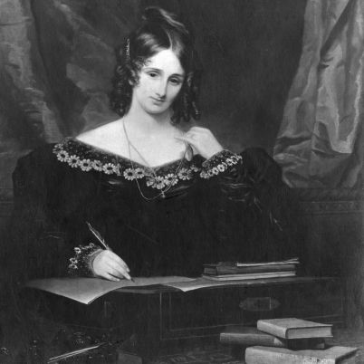
Biographical information
It is useful to start with some brief biographical information about Mary Shelley. This allows readers to gain insight into the social and historical circumstances during the production of the text. This may also provide information about Shelley’s subject position.
Mary Shelley was born in London in 1797. Her parents were both influential philosophers namely Mary Wollstonecraft (an important feminist philosopher whose work A Vindication of the Rights of Women is often viewed as an early feminist text) and William Godwin.

Slide 15
Historical context
The major movements in English literature are often identified as such
Renaissance (+- 1500-1660)
Notable writers: William Shakespeare, Edmund Spenser
Romanticism (+- 1785-1837)
Notable writers: William Blake, William Wordsworth, Percy Bysshe Shelley
Victorianism (+- 1837-1901)
Notable writers: George Eliot, Thomas Hardy, Lord Tennyson
Modernism (+- 1914-1939)
Notable writers: Virginia Woolf, TS Eliot, William Butler Yeats
Postmodernism (+-1939-present)
Notable writers: Jack Kerouac, Salman Rushdie, Zakes Mda

Slide 16
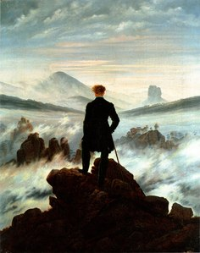
Romanticism
To begin, Romanticism has little to do with romance, but everything to do with Romance.
Romanticism was an artistic and ideological movement which began in England in the late 18th century (1700s). It was, in many ways, a reaction against the technological progress of the Industrial Revolution. Importance and value were placed on emotions and feelings rather than logic and science, nature and the environment rather than technology and industry.
Major figures in this movement include William Blake, William Wordsworth, and Percy Bysshe Shelley.
The thematic focuses for Romantic poetry include the concepts of liberty, individuality, and the concept of the ‘sublime’ in nature.
Do you notice these concerns in Shelley’s Frankenstein

Slide 17
Key Facts
Genre: Gothic science fiction (horror), novel
Narrator: The primary narrator is Robert Walton, who, in his letters, quotes Victor Frankenstein’s first-person narrative at length. Victor, in turn, quotes the monster’s first-person narrative; in addition, the lesser characters Elizabeth Lavenza and Alphonse Frankenstein narrate parts of the story through their letters to Victor.

Slide 18
Key Facts
Protagonist: Victor Frankenstein/creature?
Antagonist: Creature/Victor Frankenstein?
Setting (time): Eighteenth century (late 1700s & early 1800s)
Setting (place): Geneva; the Swiss Alps; Ingolstadt; England and Scotland; the northern ice
Tone: Romantic language, very emotional, tragic

Slide 19
Key Facts
Point of view: The point of view shifts with the narration, from Robert Walton to Victor Frankenstein to Frankenstein’s creature, then back to Walton.
Falling action: After the murder of Elizabeth Lavenza, when Victor Frankenstein chases the creature to the northern ice, is rescued by Robert Walton, narrates his story, and dies.

Slide 20
Characters
Robert Walton - The Arctic seafarer whose letters open and close Frankenstein. Walton picks the bedraggled Victor Frankenstein up off the ice, helps nurse him back to health, and listens to Victor’s story.
Henry Clerval - Victor’s boyhood friend, who nurses Victor back to health in Ingolstadt. After working unhappily for his father, Henry begins to follow in Victor’s footsteps as a scientist.

Slide 21
Characters
Alphonse Frankenstein - Victor’s father, very sympathetic toward his son. Alphonse consoles Victor in moments of pain and encourages him to remember the importance of family.
Elizabeth Lavenza - An orphan, four to five years younger than Victor, whom the Frankensteins adopt.
Justine Moritz - A young girl adopted into the Frankenstein household while Victor is growing up. Justine is blamed and executed for William’s murder, which is actually committed by the creature.
William Frankenstein - Victor’s youngest brother and the darling of the Frankenstein family. The creature strangles William in the woods outside Geneva in order to hurt Victor for abandoning him.

Slide 22
Characters
Victor Frankenstein’s life story is at the heart of Frankenstein. As a young Swiss boy, he grows up in Geneva reading works of the ancient and outdated alchemists.
This background changes his life when he attends university at Ingolstadt.
There he learns about modern science and, within a few years, masters all that his professors have to teach him.
Victor becomes fascinated with the “secret of life,” discovers it, and brings a hideous creature to life.
Soon after this, Victor abandons his creation, resulting in the creature coming after Victor’s entire family and his best friend Henry.

Slide 23
The creature/demon
The creature is Victor Frankenstein’s creation, assembled from old body parts and strange chemicals, animated by a mysterious spark. It enters life as an eight-feet tall and enormously strong, but with the mind of a new-born.
Abandoned by its creator and confused, it tries to integrate itself into society, only to be shunned universally by all humans. Looking in the mirror, it realizes its physical ugliness; an aspect of its persona that blinds society to its – initially – gentle and kind nature.

Slide 24
Science Progress Knowledge Ignorance
The pursuit of knowledge is at the heart of Frankenstein, as Victor attempts to surge beyond accepted human limits and access the secret of life.
Victor’s act of creation eventually results in the destruction of everyone dear to him.
Robert Walton attempts to surpass previous human explorations by endeavouring to reach the North Pole.
Walton finds himself helplessly trapped between sheets of ice.

Slide 25
Science Progress Knowledge Ignorance
Whereas Victor’s obsessive hatred of the creature drives him to his death, Walton ultimately decides to abandon his adventurous mission. Walton allows himself to learn from Victor’s tribulations with excessive hunger for new discoveries and creations: too much knowledge can be dangerous.
In Shelley's time, the power of human reason, through science and technology, challenged many traditional precepts about the world and man's relationship with his creator.

Slide 26
Science Progress Knowledge Ignorance
Yet at the same time, many questioned these humanist notions, stressing the limits of human capacity.
Shelley makes an allusion to the counter-humanist idea (in Ch. 4): Victor warns Walton not to follow in his footsteps, saying, ‘learn from me, if not by my precepts, at least by my example, how dangerous is the acquirement of knowledge, and how much happier that man is who believes his native town to be the world, than he who aspires to become greater than his nature will allow’.
To Shelley and many others of her time, some riddles of nature should never be discovered by man.

Slide 27
Family & Parenthood
The one nice family we see ends up exiled in a cottage in the middle of the woods.
It's not much of an advertisement for family togetherness.
Victor & the creature as a metaphor for parenthood: the creature is constantly pleading to Victor for guidance, for love, for protection, for companionship & a family.
Victor fails to be a role model for his own creation (child): refuses to be responsible, to account for his (his alone: no woman assisted him in the reproduction of the creature) actions.

Slide 28
Human Injustice
The monster laments over man's cruelty to those who are different from them.
The monster is the epic centre of action: 8-feet-tall and hideously ugly, the monster is rejected by society.
The creature’s size is not only due to its ugly appearance but also from the asexual manner of its creation: a mix of stolen human body parts, chemicals, and scientific theories/knowledge.

Slide 29
Monstrosity/Human Injustice
The creature is a product of - not collaborative scientific effort but - dark, supernatural workings.
Is Victor a monster? His ambition, secrecy, and selfishness alienate him from human society. Ordinary on the outside, but a demon (of sorts) on the inside?
The monster's alienation from society, his unfulfilled desire for a companion with whom to share his life, and his on-going struggle for revenge, are all shared by his creator. Both live in relative isolation from society, both hate their own miserable lives, and both know suffering.
Finally, many have argued that the novel itself is monstrous: a stitched-together combination of different voices, texts, and tenses!

Slide 30
Human Injustice
Texts (style): the narrative structure is made up of letters, some notes, and other writings. This is likely to be a strategy to highlight a tendency of shedding responsibility and/or an unwillingness to account for one’s action: this, for Shelley, is equal to a cruel, dark and evil side of human society.
Walton’s letters cover the whole story; Victor’s story fits inside Walton’s letters; the creature’s side of the story is sandwiched inside Victor’s story. Begging the Q: who takes responsibility for any misrepresentation of the main characters actions, challenges, and experiences.

Slide 31
Sexist Viewpoints
Frankenstein, evidently, lacks strong female characters.
Throughout his narrative, Victor portrays women as weak, suffering, subservient beings who live for and depend on the men in their lives.
Caroline Beaufort is a self-sacrificing mother who dies taking care of her adopted daughter; Justine is executed for murder, despite her innocence; the creation of the female monster is aborted by Victor because he fears being unable to control her actions once she is animated; Elizabeth waits, impatient but helpless, for Victor to return to her, and she is eventually murdered by the creature.
Why? Discuss.

Slide 32
Sexist Viewpoints
Ironically, the creature - the one who Victor calls a barbarian - has a very progressive notion of the opposite sex.
The creature believes that men and women are largely equal.
The monster's desire for a female companion does not convey a desire to rule over a woman or a belief that a woman should be dependent on him, but it simply shows his need for an “equal” companion with whom to share his life.

Slide 33
Thank you

