Slide 1
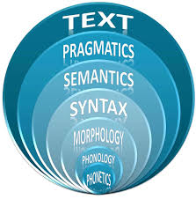
Pragmatics
AENG311

Slide 2
What is Pragmatics
oday's Zits:
It’s the use of language in concrete situations.
We are concerned with illocutionary force which means:
‘saying is doing’ i.e. speech acts.

Slide 3
Speech Acts
When a speaker in a particular set of circumstances makes an utterance,
which contains a referring expression,
he carries out a certain act.
Referring is a linguistic act, but it is possible,
using a language to carry out all sorts of acts.

Slide 4
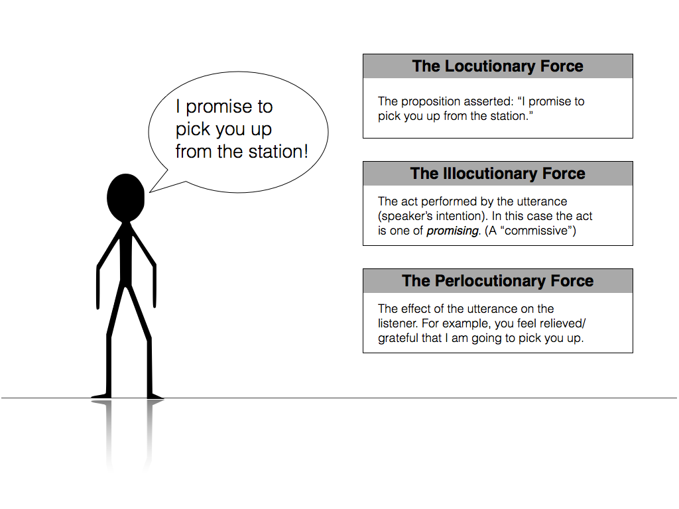
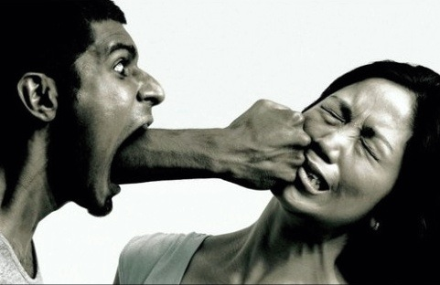
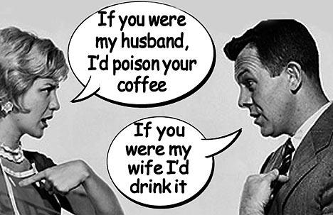
Kinds of Acts
There are three kinds of acts:
Locutionary acts – locutions
Illocutionary acts – illocutions
Perlocutionary acts – perlocutions

Slide 5
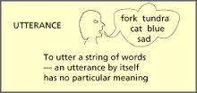
Locutionary Act
It’s the performing of the act OF saying something.
This is the literal meaning of the utterance.

Slide 6
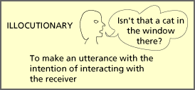
Illocutionary Act
I’ve just made some coffee.
It’s performing an act IN saying something.
It’s the use to which the speaker puts his utterance.
Example:
‘making a promise’
Notes:
Start here

Slide 7
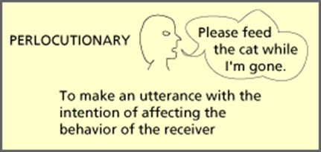
Perlocutionary Act
It’s performing an act BY saying something.
This has to do with the effect the utterance has on the speaker.
Perlocutionary act is the actual effect, an action or state of mind brought about by, or as a consequence of, saying something.
Perlocutionary effect is in some sense external to the performance, it may be thought of, in a sense, as the effect of the illocutionary act.
Therefore, when examining perlocutionary acts, the effect on the hearer or reader is emphasized.

Slide 8
Act of Assertion
It’s the act of stating something.
It’s carried out when a speaker utters a declarative sentence (which can be either true or false).
The speaker undertakes a certain responsibility, or commitment, to the hearer, that a particular state of affairs, or situation, exists in the world.

Slide 9
Act of Assertion
Example:
Thoko is in the hospital.
This utterance asserts to the hearer that a situation exists in the world, where an individual ‘Thoko’ (referring expression) exists in a place identified by the referring expression ‘hospital’.

Slide 10
Descriptive Fallacy
This relates to the theory that assertions only exist for purposes of describing the state of affairs.
In other words, it was assumed that there was not much more to the meanings of sentences (and utterances) than this kind of correspondence between sentences (and utterances) and the world.

Slide 11
Descriptive Fallacy
The DESCRIPTIVE FALLACY is the view that the sole purpose of making assertions is to DESCRIBE some state of affairs.
According to the Descriptive Fallacy view, the only purpose in uttering ‘Thoko is in the hospital’ would be to describe a particular state of affairs, and nothing more.

Slide 12
Descriptive Fallacy
The Descriptive Fallacy view is not wholly wrong.
An element of description is involved in many utterances. But description is not indulged in only for its own sake.
There is usually a more basic purpose behind an utterance.

Slide 13
Descriptive Fallacy
Example:
Smoking is dangerous to your health.
The basic purpose of this utterance is to WARN.
That is, BEWARE, SMOKING CAN KILL YOU.
One sentence can in this way have several different acts depending on who utters it, how and in what circumstances.

Slide 14
Practice
For each of the following four utterances state one or two purposes that the speaker may have had in mind when uttering them.
Example:
There’s a wasp in your left ear.
To warn the hearer of the danger of being stung, or to shock him (or both).
(1) ‘Someone has broken the space-bar on my typewriter’ …………………………………………………………………………………………………. (2) ‘This gun is loaded’ ……………………………………………………………………………………………….... (3) ‘You are a fool’ …………………………………………………………………………………………………. (4) ‘I love you’ ………………………………………………………………………………………………...
To complain about the damage, or to apologize to someone about to borrow the machine, etc.
As a warning during an armed robbery, or as an example during an elementary weapon-training lesson for soldiers, etc.
To insult the hearer, or, between intimates, to tease him, or to impress a bystander with one’s directness of manner, etc.
To reassure the hearer, or to console him, or to make him feel indebted, or to please him, etc.

